Slide 1
GDPR Overview
For Fitwise Clients
April 2020
Katie Hill, Head of Marketing, Fitwise

Slide 2
What these slides include:
Role of Fitwise
What is a data breach
GDPR responsibilities as Council/Board / Exec Members
GDPR for Your Events
Queries
Please note that theses slides are not designed to be all encompassing but have been developed to provide an overview and signpost you to further information.
Fitwise are not lawyers but we are sharing our processes which we worked through and were approved by Lawyers Gilson Grey during GDPR implementation.

Slide 3
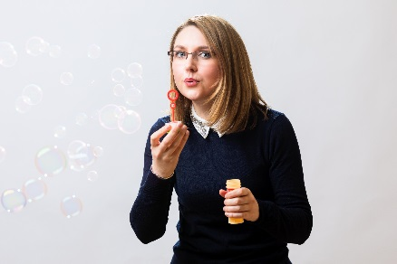
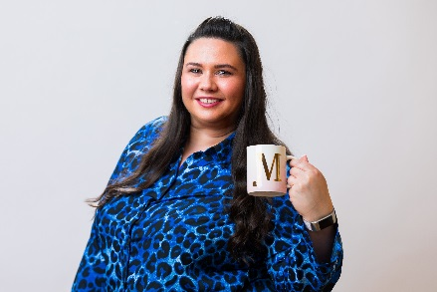
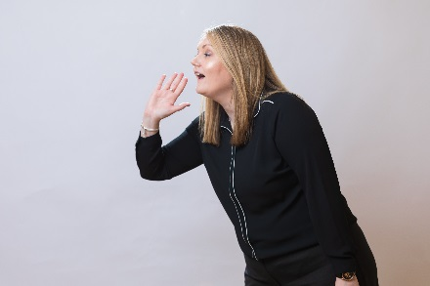
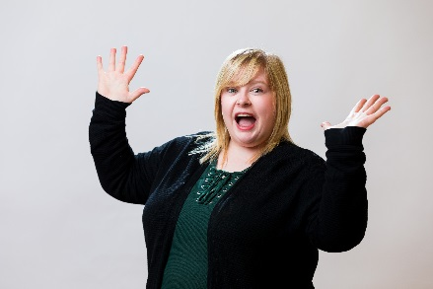
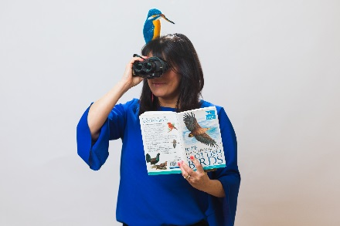
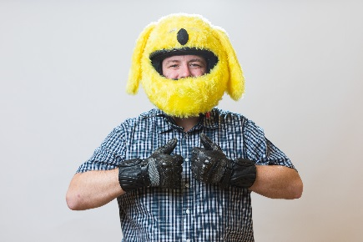
Role of Fitwise
Fitwise have a Privacy Officers Group:
Central point of contact for personal data processing matters for Fitwise and Clients
The group can be reached at: privacyofficers@fitwise.co.uk
The group deals with:
Data Breaches
Subject Access Requests
Right to be Forgotten Requests
Data Retention
Advice
The group has a SOP which can be shared if required.

Slide 4
Data Breach
What is a Data Breach?
Unauthorised access
Deliberate or accidental action (or inaction)
Incorrect recipient
Lost or stolen computing device
Altering personal data
Loss of availability of personal data
“a personal data breach means a breach of security leading to the accidental or unlawful destruction, loss, alteration, unauthorised disclosure of, or access to, personal data.”

Slide 5
Your GDPR Responsibilities
The GDPR responsibilities as Board / Exec / Council members (to include Branch Chairs) are to ensure that:
Members’ personal details are kept secure – ie: password protected on a secure system
Members details are not shared with anyone – this includes sending to any third party
Members details are only used for official Society Business
Members details are subject to a sensible retention period - ie: when you receive a new list make sure to delete the old list
Emails are subject to extreme care:
Members should be emailed by using the BCC box (or via the Society website if set up)
Any data received via email should be securely saved and the email itself deleted
Any data breaches (no matter how small) must be reported within 24 hours to: privacyofficers@fitwise.co.uk

Slide 6
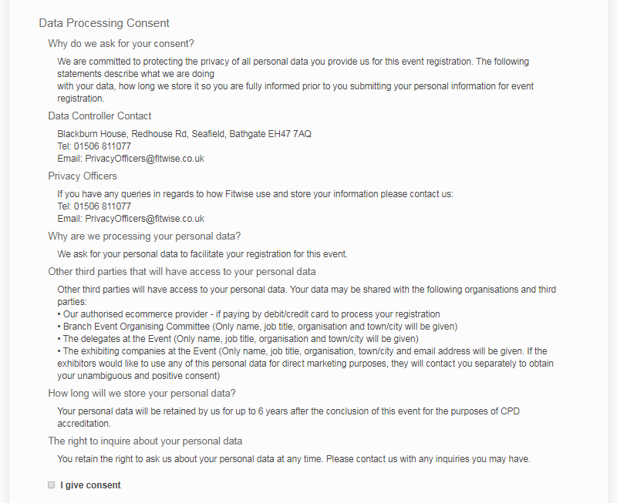
GDPR For Your Events
If you are organising your own event these are the areas you need to consider:
Ensure that when you ask delegates to register you ask for consent to process their information. As part of this:
Let them know why their data is being processed
Let them know who will have access to the data (eg Society organising group / exhibitors)
Let them know how long their data will be retained (6 years for CPD purposes)
For an example see any Fitwise event eg. CLICK HERE
Ensure all delegate data is being stored securely - password protected on a secure system (be aware that some of this information may be sensitive personal information – for example a special diet may indicate religious belief, and access requirements may indicate medical information)
No delegate or exhibitor payment details should be stored
In order to process speaker expenses you need get an opt in, eg:
I am happy for Fitwise Management Ltd to process my personal data for the purposes of processing this expense form (TICK BOX)

Slide 7
GDPR For Events - Marketing
Marketing:
If you want to retain delegate information for future marketing purposes you need to secure a separate opt in: Eg:
This list also needs to be subject to a sensible retention period. On your Retention Policy it is 3 years for marketing purposes, following which the lists should be deleted.
When marketing to these lists you must have an ‘Opt out’ function. Anyone that opts out must not be receive marketing emails going forward. (Please note that they can receive transactional (payment details) / information emails pertaining to the event they are attending.)
To view your Privacy Policy, Cookie Policy and Retention Policy visit your website. They are linked in the footer of the homepage.

Slide 8
Any Queries, please direct to:
Katie Hill Head of Marketing, Fitwise
01506 292037 / privacyofficers@fitwise.co.uk

